Slide 1

Elite Team
A select group that is superior in terms of ability or
qualities to the rest of a group or society

Slide 2
B9 Project Team (Health And Insurance) Team member
PALLAVI AUNDHE
HUMA KAZI
SHUBHAM GOSAVI
KANCHAN DHAGE
GOVIND JADHAV
SHRUTIKA MAHALE
POOJA BHAGAT
DEEPIKA BURGONI
LAXMI BURGONI

Slide 3
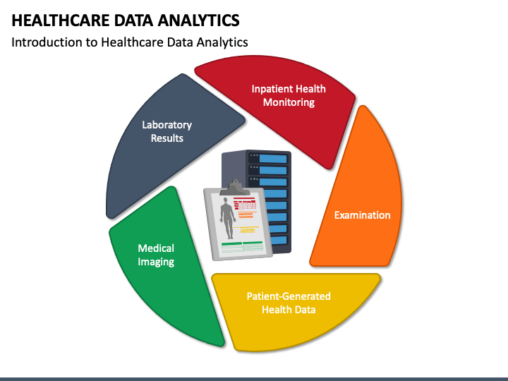
1) Our project focuses on how data can help make health and insurance services better. 2) Using Big Data, we want to find important information and trends to improve decision- making. 3) We will analyze data to make healthcare better and find ways to reduce risks and save money in insurance. 4)Our goal is to handle data responsibly and follow the rules to protect people's privacy. 5)By using data smartly, we aim to make healthcare and insurance services more efficient and helpful for everyone.
Introduction Of Bigdata In Health And Insurance for project

Slide 4
Need and Benefits For Insurance Data Analysis
Needs :-
• Parallel Data Processing that is unconstrained.
• Provide storage for billions and trillions of unstructured data sets.
• Fault tolerance along with high availability of the system.
Benefits:-
• Integrated, Hadoop solution for the enterprise
• Faster time to deployment
• Automated, consistent, dependable deployment and management
• Simplified operation that can be quickly learned without systems administration experience

Slide 5
Health and Insurance Data Analysis Architecture

